Slide 1
DC Machine Construction
CSE A & B
By
Ms. Alagu Dheeraj

Slide 2
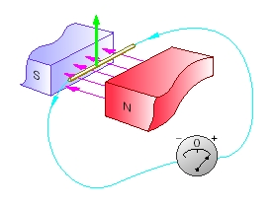
DC Generator
Mechanical energy is converted to electrical energy
Three requirements are essential
1. Conductors
2. Magnetic field
3. Mechanical energy

Slide 3
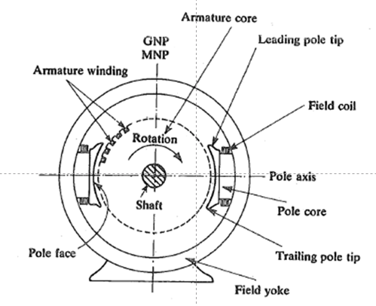
Construction of DC Generator
Field system
Armature core
Armature winding
Commutator
Brushes

Slide 4
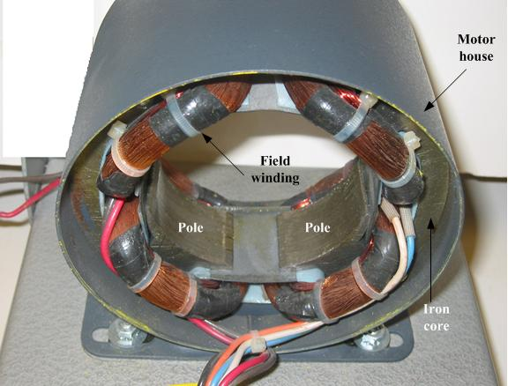
DC Machine Construction
The poles are mounted on an iron core that provides a closed magnetic circuit.
The rotor has a ring-shaped laminated iron core with slots.
Coils with several turns are placed in the slots. The distance between the two legs of the coil is about 180 electric degrees.

Slide 5
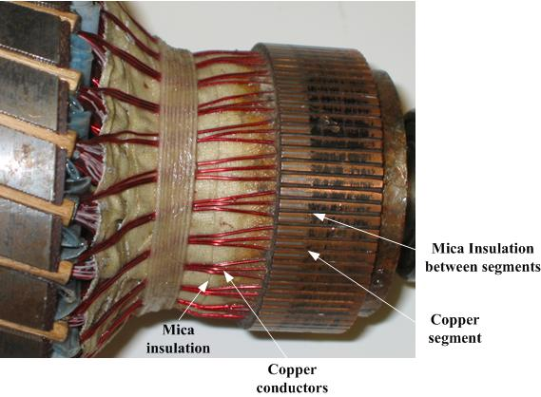
DC Machine Construction
The rotor coils are connected in series through the commutator segments.
The ends of each coil are connected to a commutator segment.
The commutator consists of insulated copper segments mounted on an insulated tube.
Two brushes are pressed to the commutator to permit current flow and they are placed in neutral zone.

Slide 6
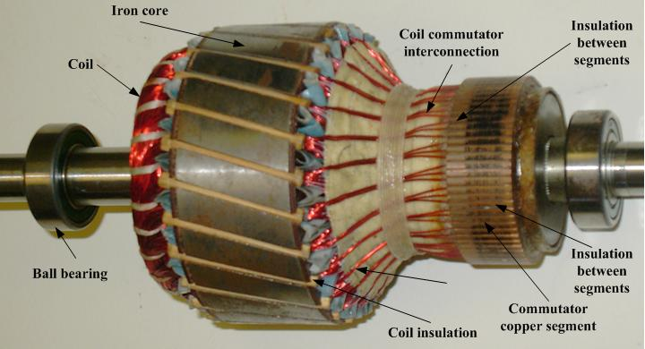
DC Machine Construction
The rotor coils are connected in series through the commutator segments.
The ends of each coil are connected to a commutator segment.
The commutator consists of insulated copper segments mounted on an insulated tube.
Two brushes are pressed to the commutator to permit current flow and they are placed in neutral zone.

Slide 7
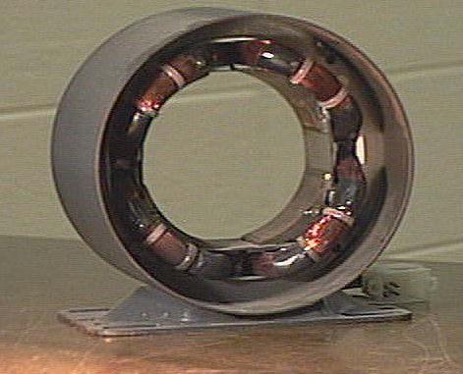
Field winding

Slide 8
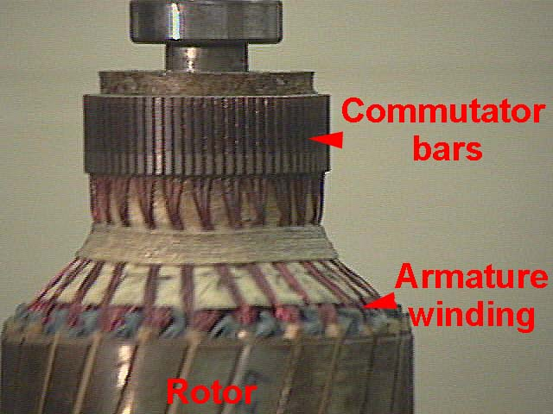
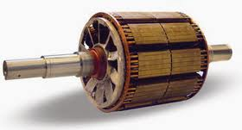
Rotor and rotor winding

Slide 9
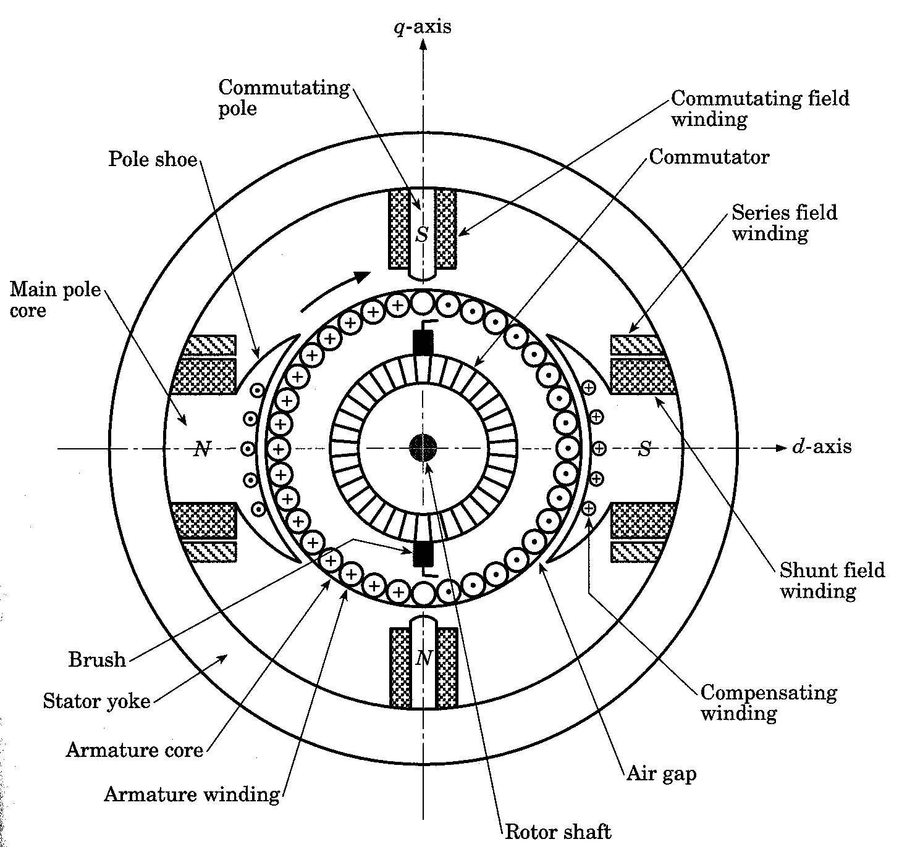
DC Machine Construction
The stator of the dc machine has poles, which are excited by either dc current or permanent magnets to produce magnetic fields.
In the neutral zone, in the middle between the poles, commutating poles are placed to reduce sparking of the commutator.
Compensating windings are mounted on the main poles. These reduces flux weakening commutation problems.

Slide 10
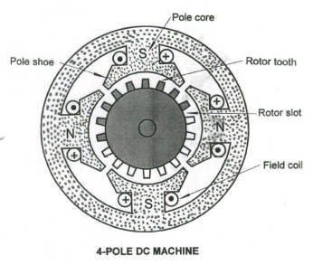
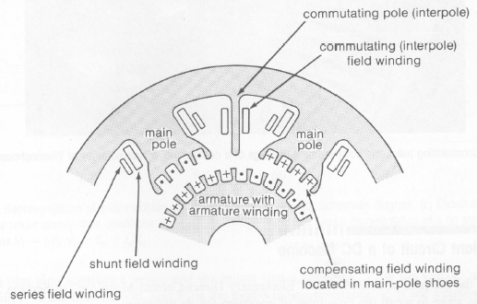
Constructional Features of DC Machines
Commutator along with the armature on the rotor
Salient-pole on the stator and, except for a few smaller machines, commutating poles between the main poles.
Field windings (as many as 4):
Two fields that act in a corrective capacity to combact the detrimental effects of armature reaction, called the commutating (compole or interpole) and compensating windings, which are connected in series with the armature.
Two normal exciting field windings, the shunt and series windings

Slide 11
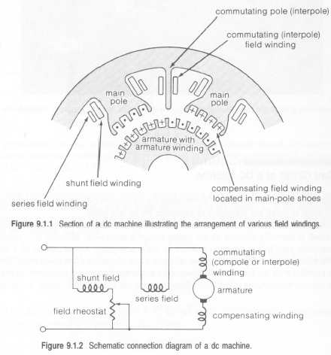
Schematic Connection Diagram of a DC Machine

Slide 12
Armature core
The armature core is cylindrical
High permeability silicon steel stampings
Impregnated
Lamination is to reduce the eddy current loss

Slide 13
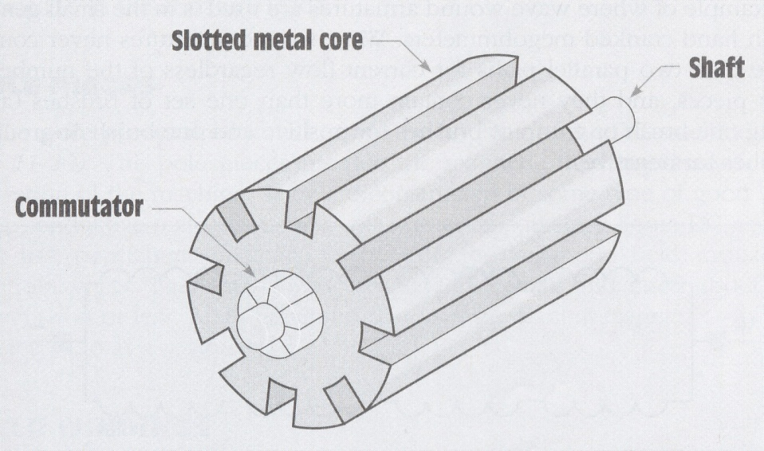
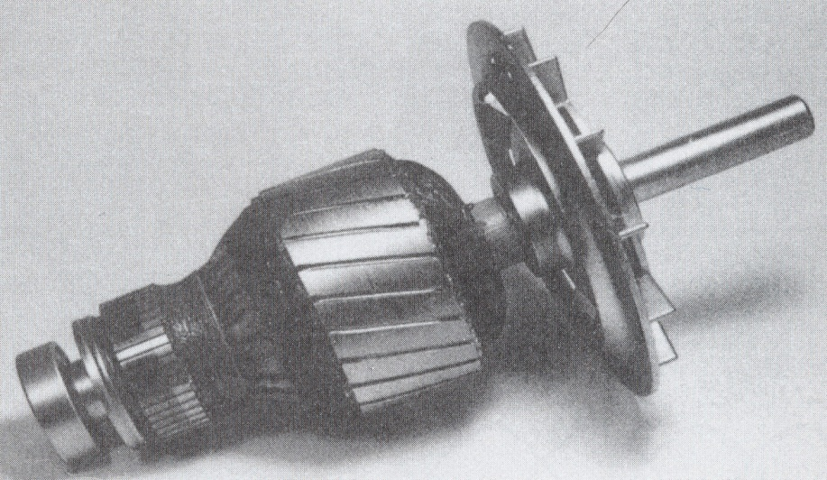
ARMATURE
More loops of wire = higher rectified voltage
In practical, loops are generally placed in slots of an iron core
The iron acts as a magnetic conductor by providing a low-reluctance path for magnetic lines of flux to increase the inductance of the loops and provide a higher induced voltage. The commutator is connected to the slotted iron core. The entire assembly of iron core, commutator, and windings is called the armature. The windings of armatures are connected in different ways depending on the requirements of the machine.
Loops of wire are wound around slot in a metal core
DC machine armature

Slide 14
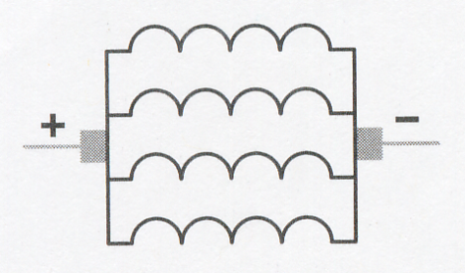
ARMATURE WINDINGS
Lap Wound Armatures
are used in machines designed for low voltage and high current
armatures are constructed with large wire because of high current
Eg: - are used is in the starter motor of almost all automobiles
The windings of a lap wound armature are connected in parallel. This permits the current capacity of each winding to be added and provides a higher operating current
No of current path, C=2p ; p=no of poles
Lap wound armatures

Slide 15
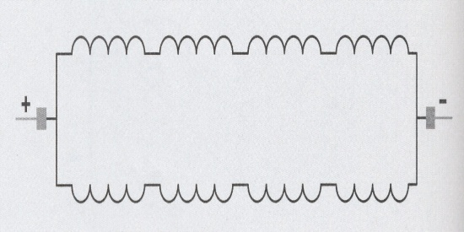
ARMATURE WINDINGS (Cont)
Wave Wound Armatures
are used in machines designed for high voltage and low current
their windings connected in series
When the windings are connected in series, the voltage of each winding adds, but the current capacity remains the same
are used is in the small generator in hand-cranked megohmmeters
No of current path, C=2
Wave wound armatures

Slide 16
Armature winding
There are 2 types of winding
Lap and Wave winding
Lap winding
A = P
The armature windings are divided into no. of sections equal to the no of poles
Wave winding
A = 2
It is used in low current output and high voltage.
2 brushes

Slide 17
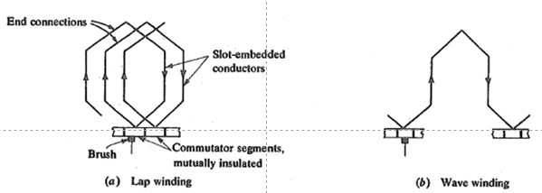

Slide 18
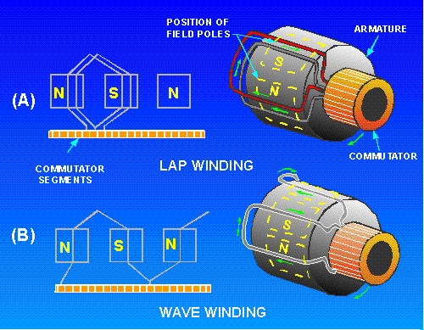
ARMATURE WINDINGS (Cont)

Slide 19
FIELD WINDINGS
Most DC machines use wound electromagnets to provide the magnetic field.
Two types of field windings are used :
series field
shunt field
Compound field

Slide 20
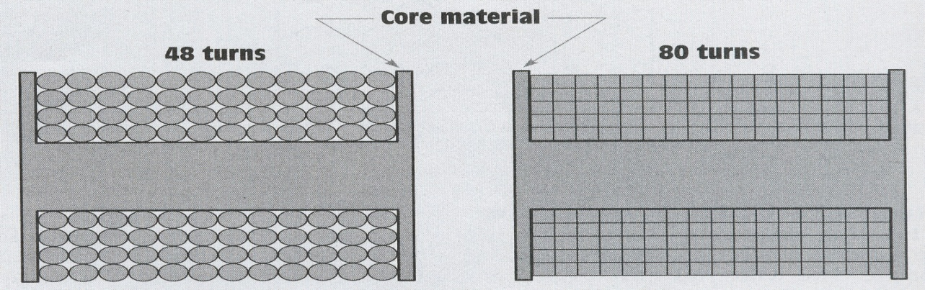
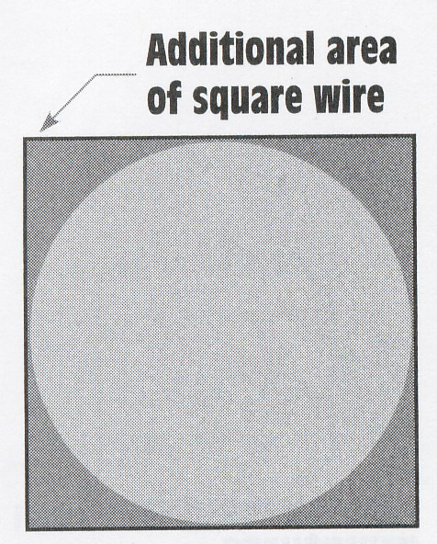
FIELD WINDINGS (Cont)
Series field windings
are so named because they are connected in series with the armature
are made with relatively few windings turns of very large wire and have a very low resistance
usually found in large horsepower machines wound with square or rectangular wire. The use of square wire permits the windings to be laid closer together, which increases the number of turns that can be wound in a particular space
Square and rectangular wire can also be made physically smaller than round wire and still contain the same surface area
Square wire permits more turns than round wire in the same area
Square wire contains more
surface than round wire

Slide 21
FIELD WINDINGS (Cont)
Shunt field windings
is constructed with relatively many turns of small wire, thus, it has a much higher resistance than the series field.
is intended to be connected in parallel with, or shunt, the armature.
high resistance is used to limit current flow through the field.

Slide 22
Field system
It is for uniform magnetic field within which the armature rotates.
Electromagnets are preferred in comparison with permanent magnets
They are cheap , smaller in size , produce greater magnetic effect and
Field strength can be varied

Slide 23
Field system consists of the following parts
Yoke
Pole cores
Pole shoes
Field coils

Slide 24
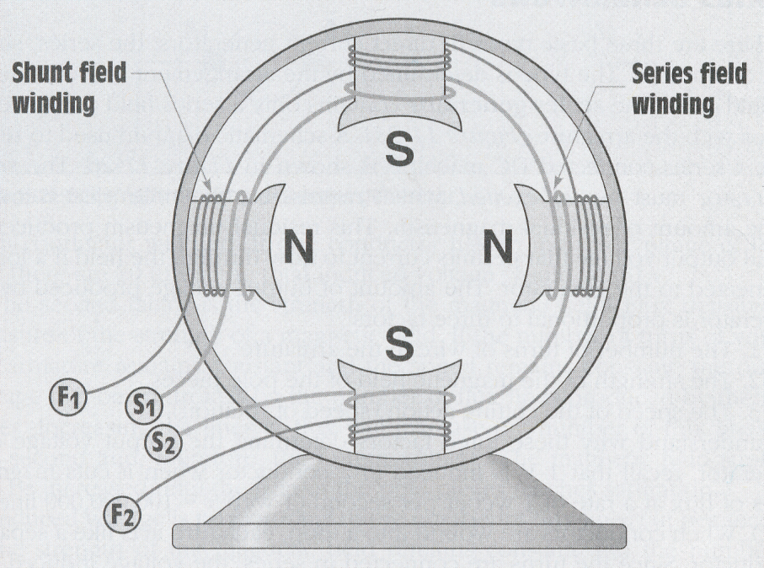
FIELD WINDINGS (Cont)
When a DC machine uses both series and shunt fields, each pole piece will contain both windings.
The windings are wound on the pole pieces in such a manner that when current flows through the winding it will produce alternate magnetic polarities.
Both series and shunt field windings are contained in each pole piece
S – series field
F – shunt field

Slide 25
MACHINE WINDINGS OVERVIEW
Winding
armature
field
Self excited
Separately
Excited
Wave
C=2
Lap
C=2p
Frogleg
series
shunt
compound

Slide 26
Commutator
Connect with external circuit
Converts ac into unidirectional current
Cylindrical in shape
Made of wedge shaped copper segments
Segments are insulated from each other
Each commutator segment is connected to armature conductors by means of a cu strip called riser.
No of segments equal to no of coils

Slide 27
Carbon brush
Carbon brushes are used in DC machines because they are soft materials
It does not generate spikes when they contact commutator
To deliver the current thro armature
Carbon is used for brushes because it has negative temperature coefficient of resistance
Self lubricating , takes its shape , improving area of contact

Slide 28
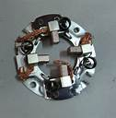
Brush rock and holder

Slide 29
Carbon brush
Brush leads (pig tails)
Brush rocker ( brush gear )
Front end cover
Rear end cover
Cooling fan
Bearing
Terminal box

Slide 30
EMF equation
Let,
Ø= flux per pole in weber
Z = Total number of conductor
P = Number of poles
A = Number of parallel paths
N =armature speed in rpm
Eg = emf generated in any on of the parallel path

Slide 31
EMF equation
Flux cut by 1 conductor
in 1 revolution = P * φ
Flux cut by 1 conductor in
60 sec = P φ N /60
Avg emf generated in 1
conductor = PφN/60
Number of conductors in
each parallel path = Z /A
E_{g} = PφNZ/60A

